Slide 1
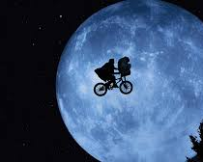
We’ll take you to the moon…
… and back again!

Slide 2
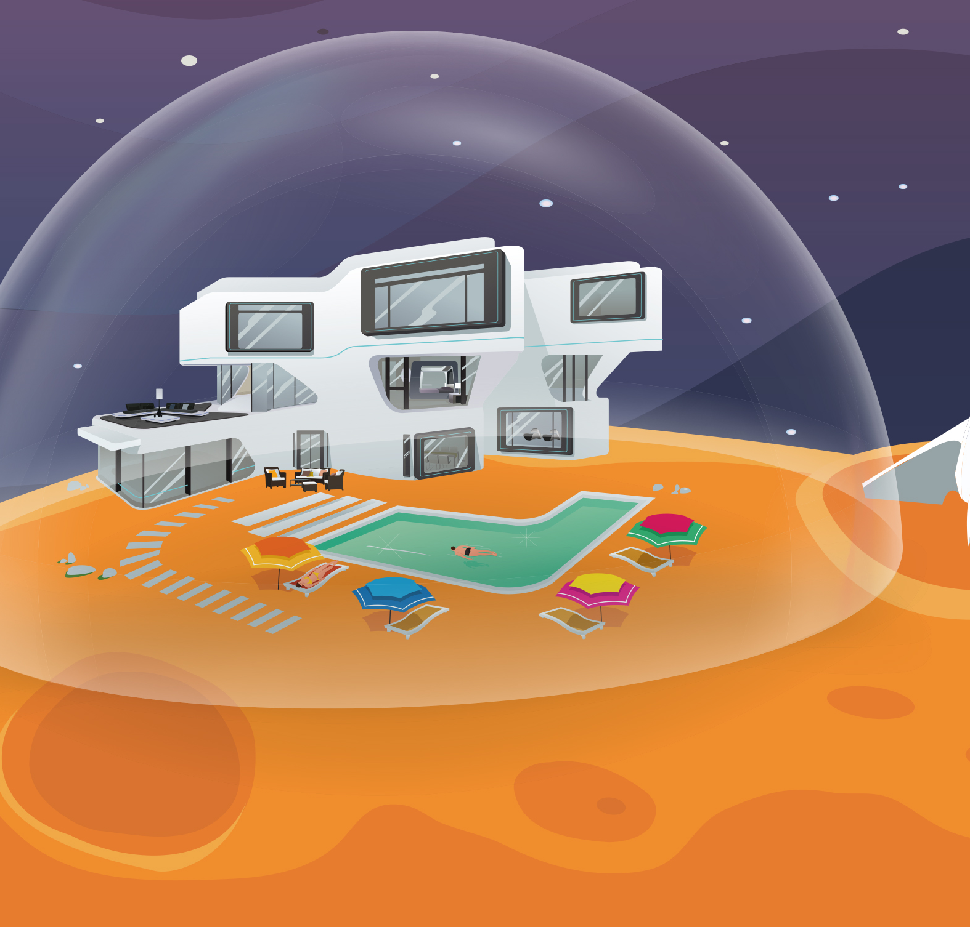
Come a stay on the moon…
We offer 5* accommodation here at the moon hotel (due to be completed in 2099)
We have fantastic facilities for your stay.
The views are out of this world.
Warning; not everything works the same as on earth especially the toilets!

Slide 3
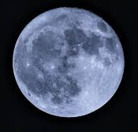
Key Facts
Earth has one moon. Other planets have more than one.
The moon is our nearest neighbour and the only natural object in space people have travelled to and walked on.
The moon is full of craters caused by space debris. Earth’s atmosphere protects it from space debris but the moon has no atmosphere. It is waterless, airless and lifeless.
Although it looks bright in the sky it doesn’t shine – it just reflects light from the sun.
It would take you about 9 years to walk to the moon so it’s best to go in a rocket which takes about 3 days to travel the 240,000 miles to get there.

Slide 4
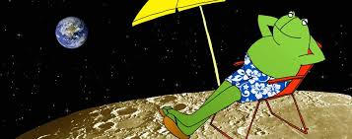
Holiday details
Blast off from Dublin airport for Florida. A quick trip to Disney World Epcot to prepare you and then a trip around the Kennedy Space Centre to learn about space before you get on a rocket for the moon. We’ll pass the International Space Station on the way so make sure and give them a wave! We need to wear our space suits before transferring into the new NASA hotel pod.
Please note you must be in good physical condition and you are taking this trip entirely at your own risk. Sometimes things go wrong and if they do you will probably die. Looking forward to seeing you!

