Slide 1
Animals endangered by Plastic Pollution
By John Black

Slide 2
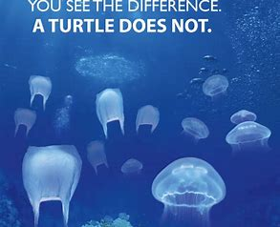
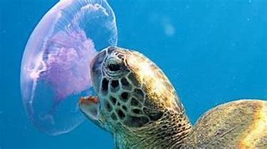
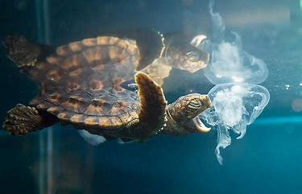
Turtles are an endangered species. One of their major threats is discarded plastic bags because turtles think they’re jellyfish. Turtles like to eat jellyfish so if they see a plastic bag they think it’s lunch and try to eat it.
Turtles drown if they get caught in nets as they need to surface to breathe

Slide 3
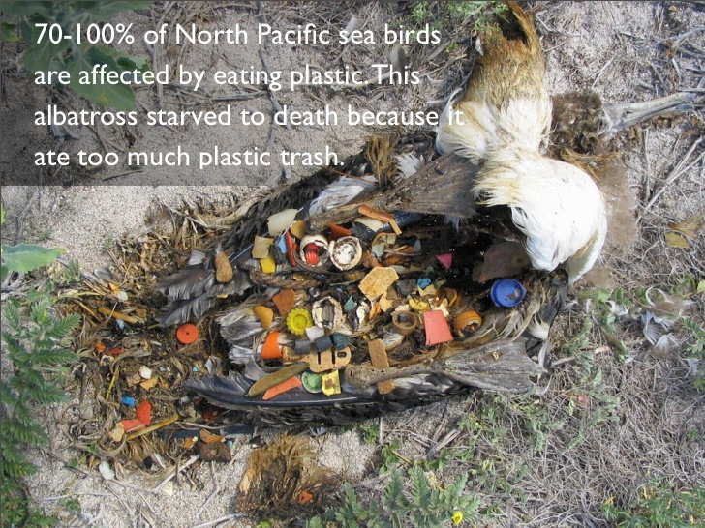
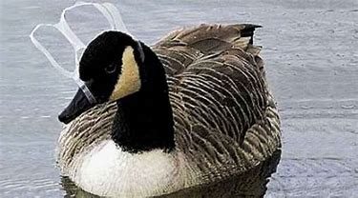
Birds are very vulnerable from plastic floating in water during their feeding

Slide 4
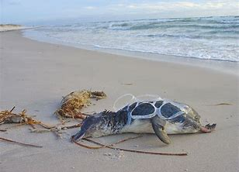
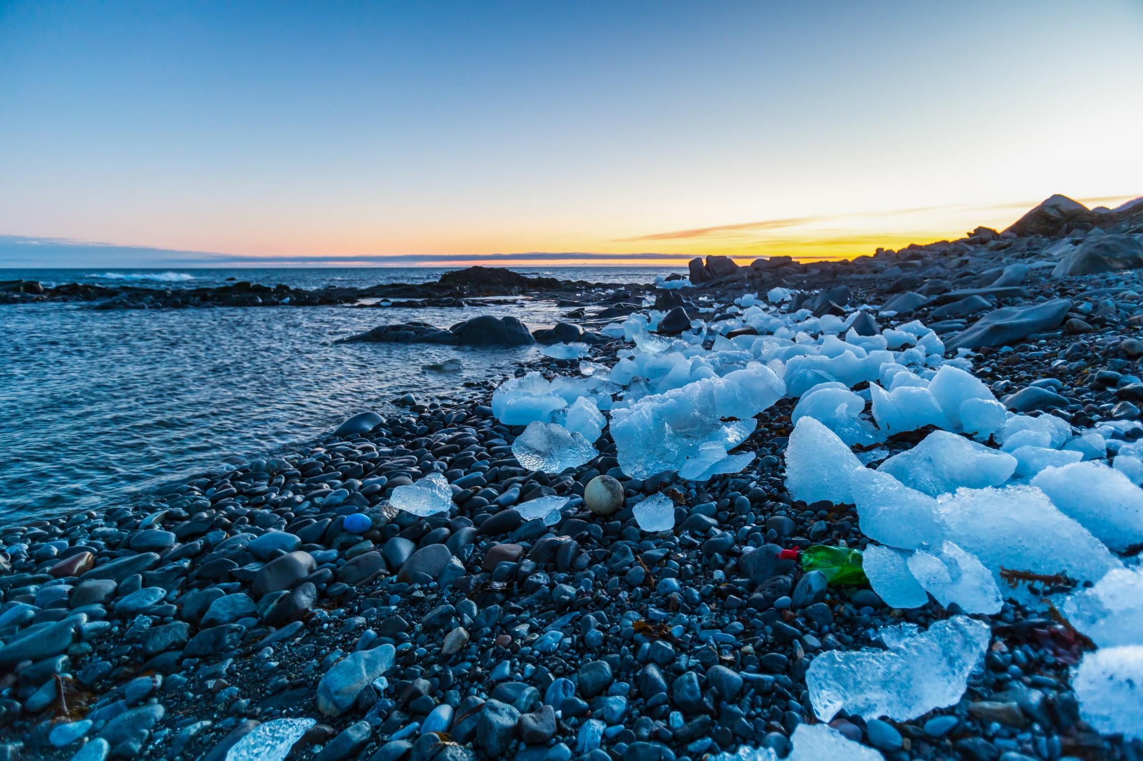
Penguins
You would think that Penguins living in Antarctica would be safe
from plastic pollution because very few people have been there.
The sea has no borders so if you drop something in the sea then over time
the currents will move it somewhere else. This is why penguins are affected by plastic.

Slide 5
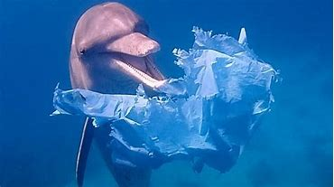
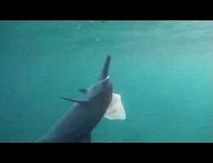
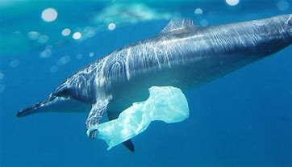
Dolphins

Slide 6
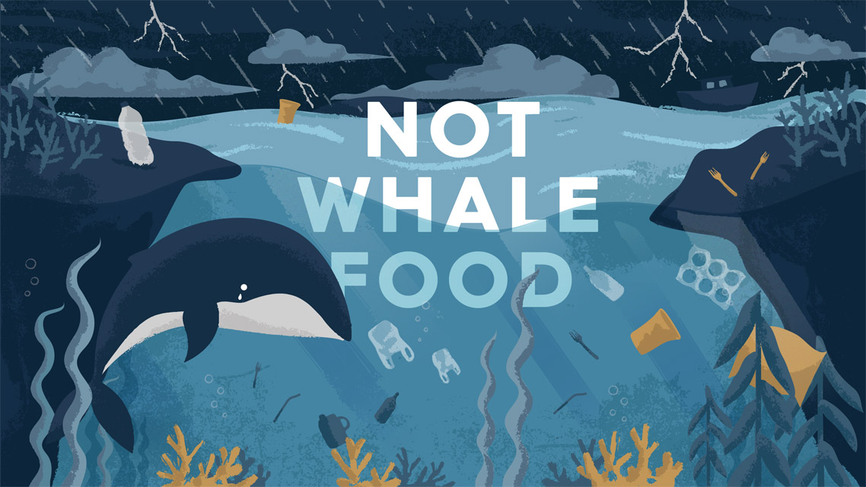
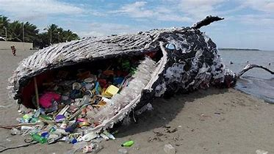
Whales

Slide 7
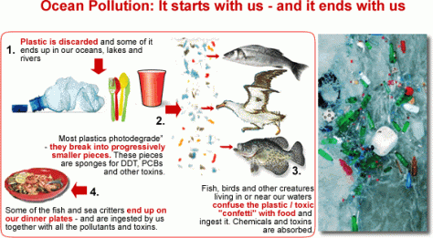
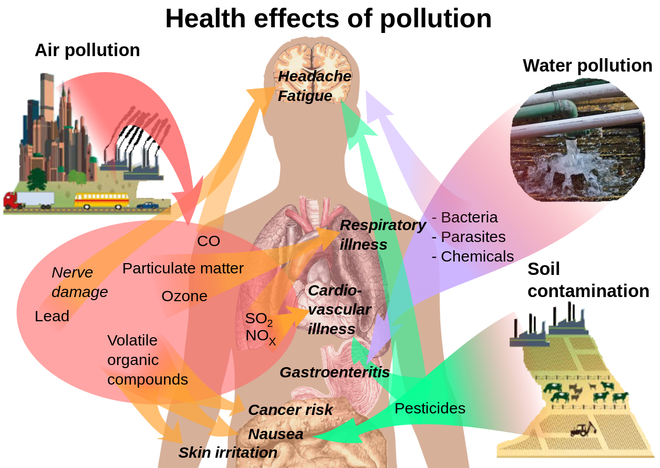
Us!
People are getting affected by plastic pollution caused by us because if you think about it if fish eat plastic and we eat fish then we are also eating plastic. Look at these diagrams which might make you realise how your actions can come back to you.

Slide 8
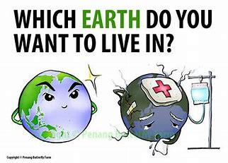
Useful Website
https://www.wwf.org.uk/updates/ten-tips-reduce-your-plastic-footprint
TEN TIPS TO REDUCE YOUR PLASTIC FOOTPRINT

Slide 10
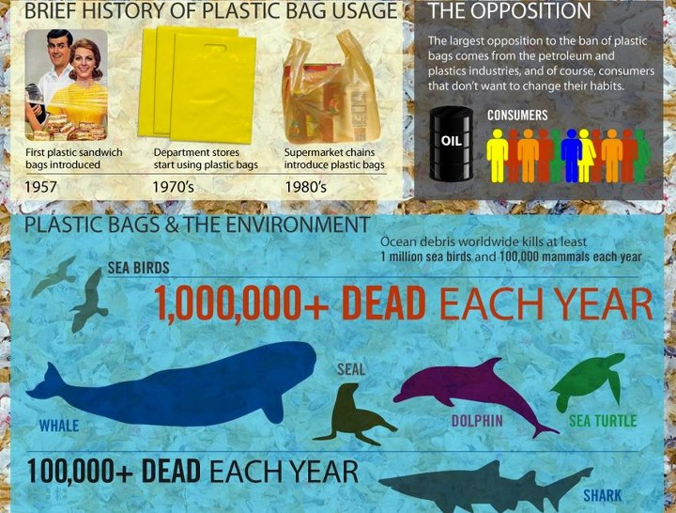

Slide 11
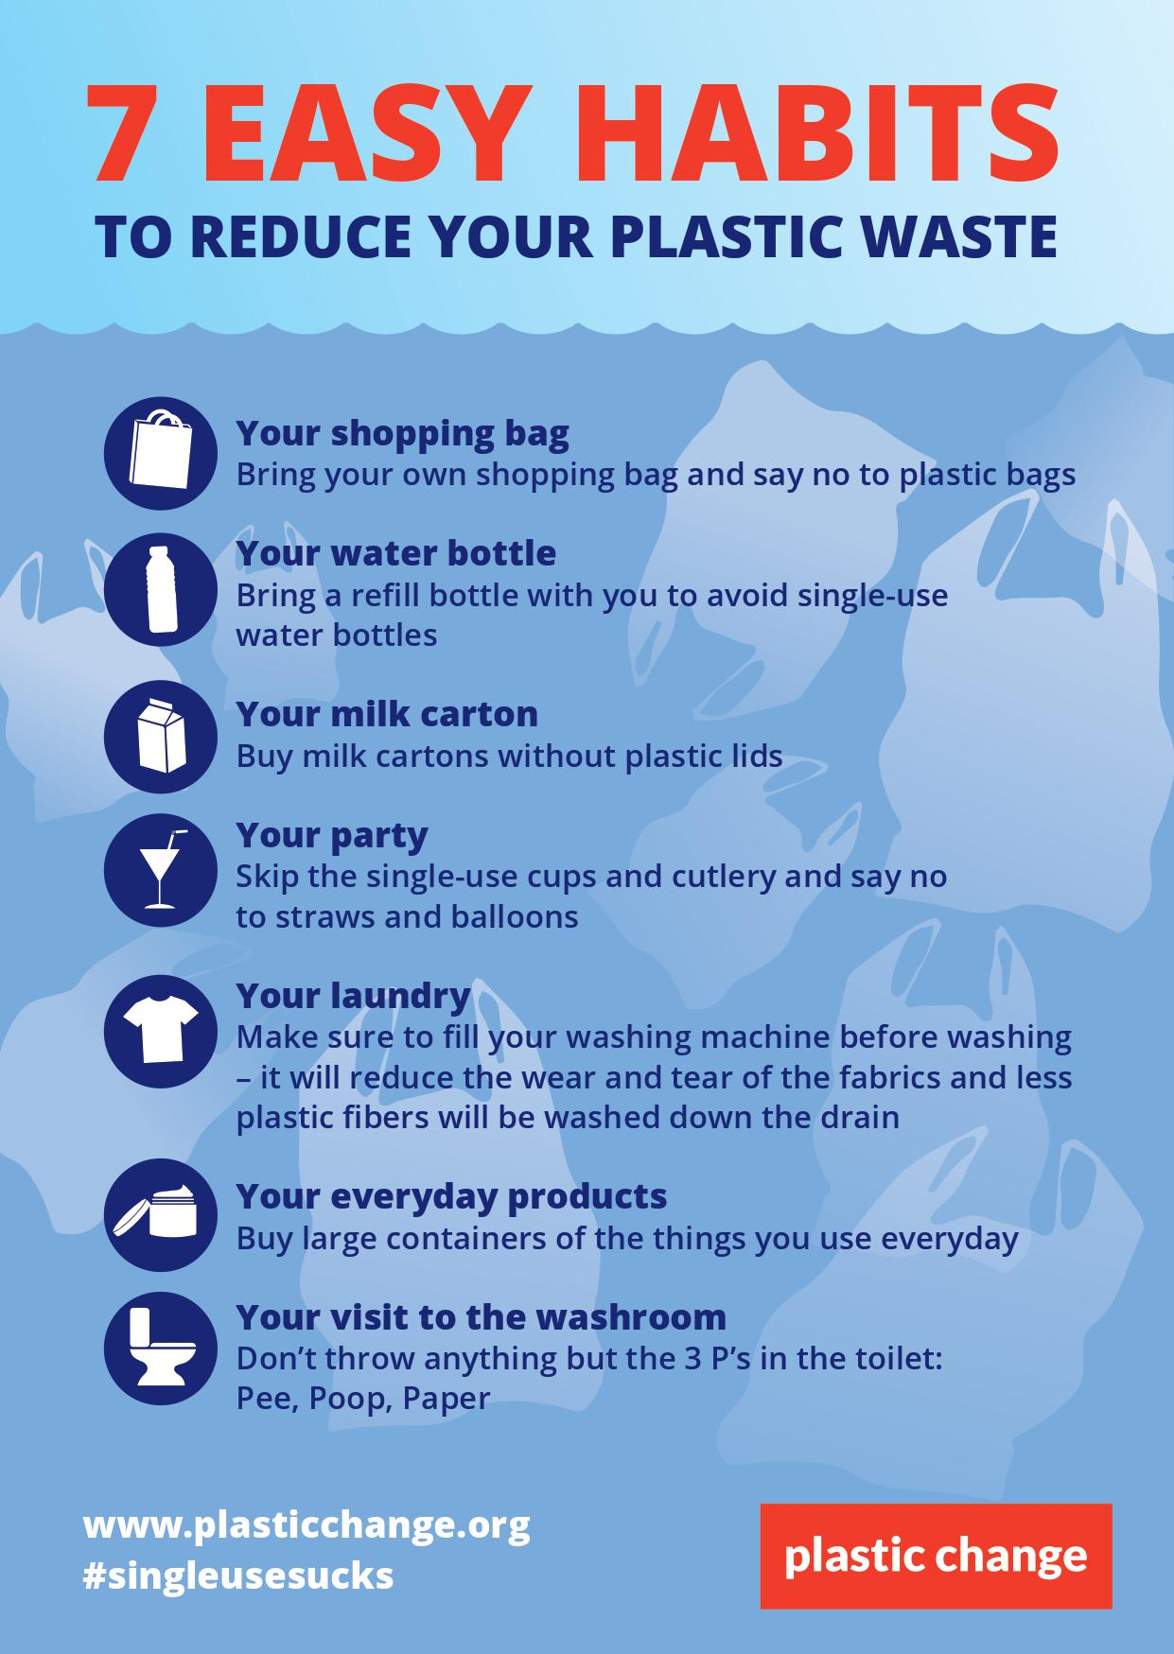
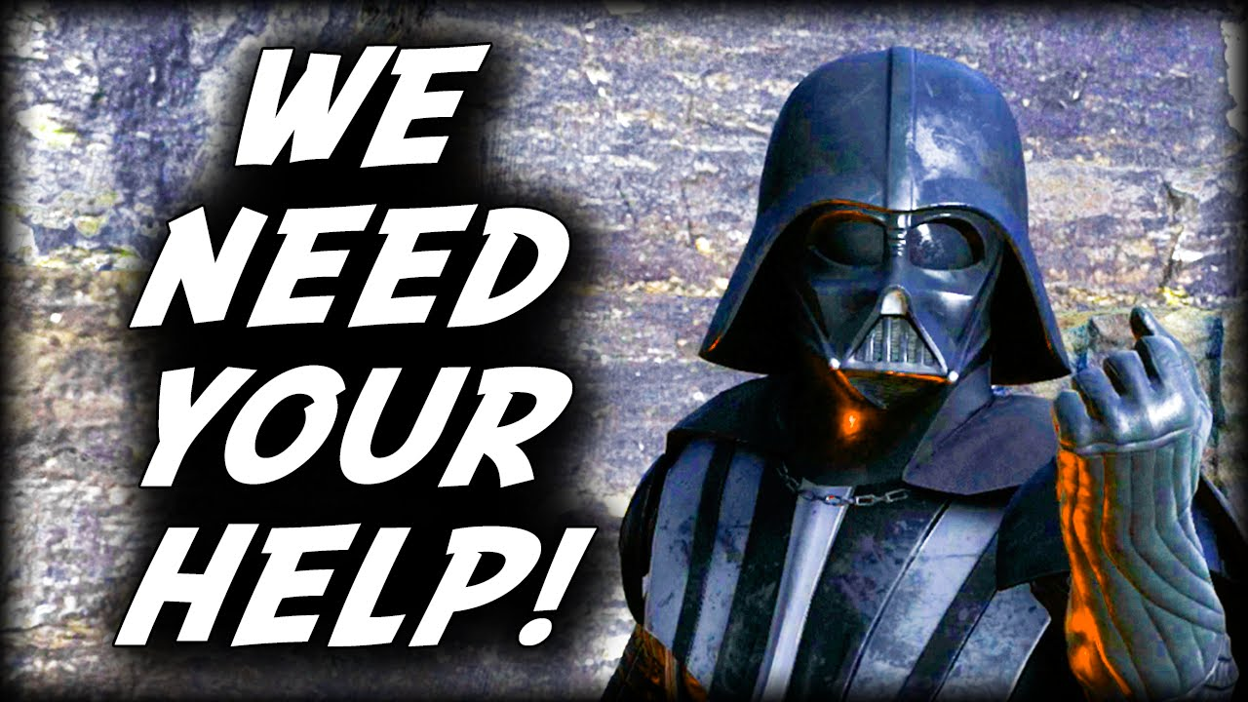
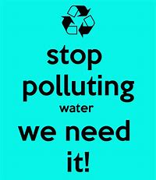
Stop Plastic Polution!

